Slide 1
EXCEL RE-ASSESSMENT
SUSHIL BHARATHI M
LVADSUSR124

Slide 2
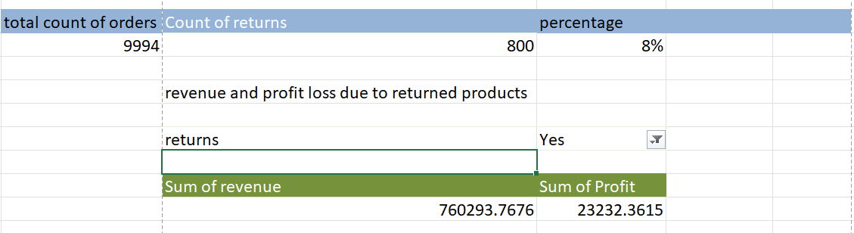
Q1
Insights: Here I have calculated the number of orders returned ,by adding the returns column from the return sheet using xlookup and was able to calculate the revenue and profit lost for the products returned
Inference:
I have calculated the count ,profit lost and revenue lost for the returned products

Slide 3
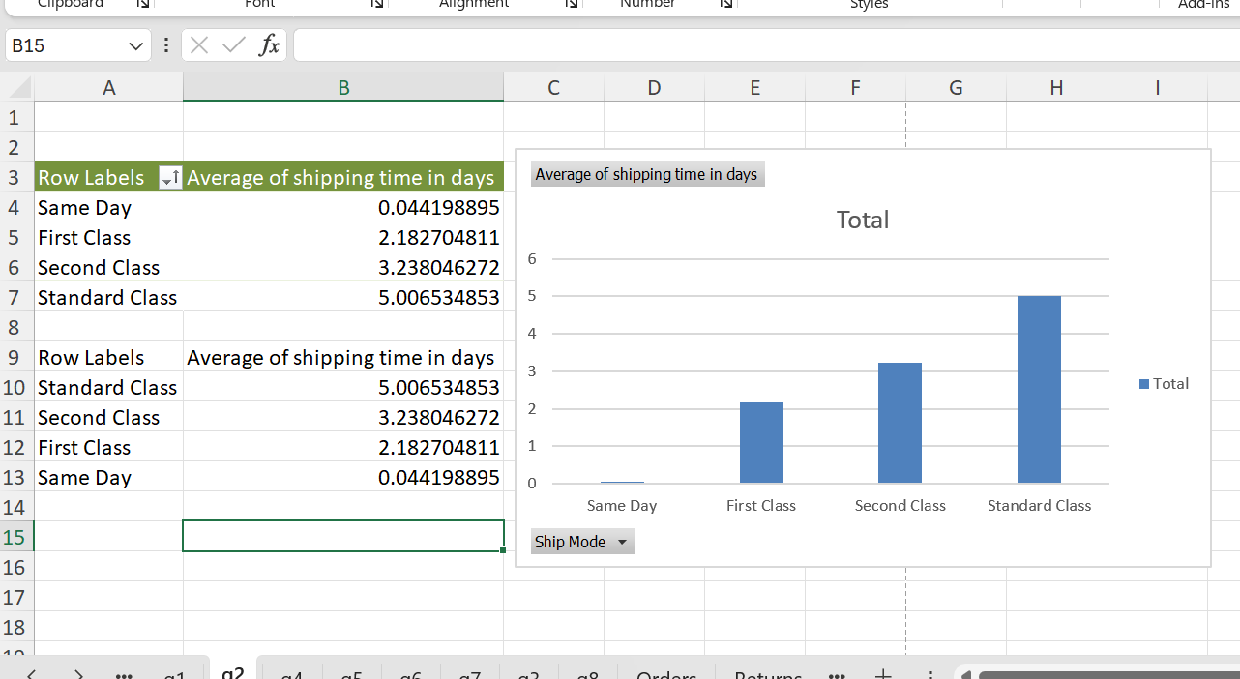
Q2
Insights: Here I have found the the fastest and slowest mode of shipping using pivot table and represented it using a bar chart
Inference: I have found the fastest and slowest mode of shipping

Slide 4
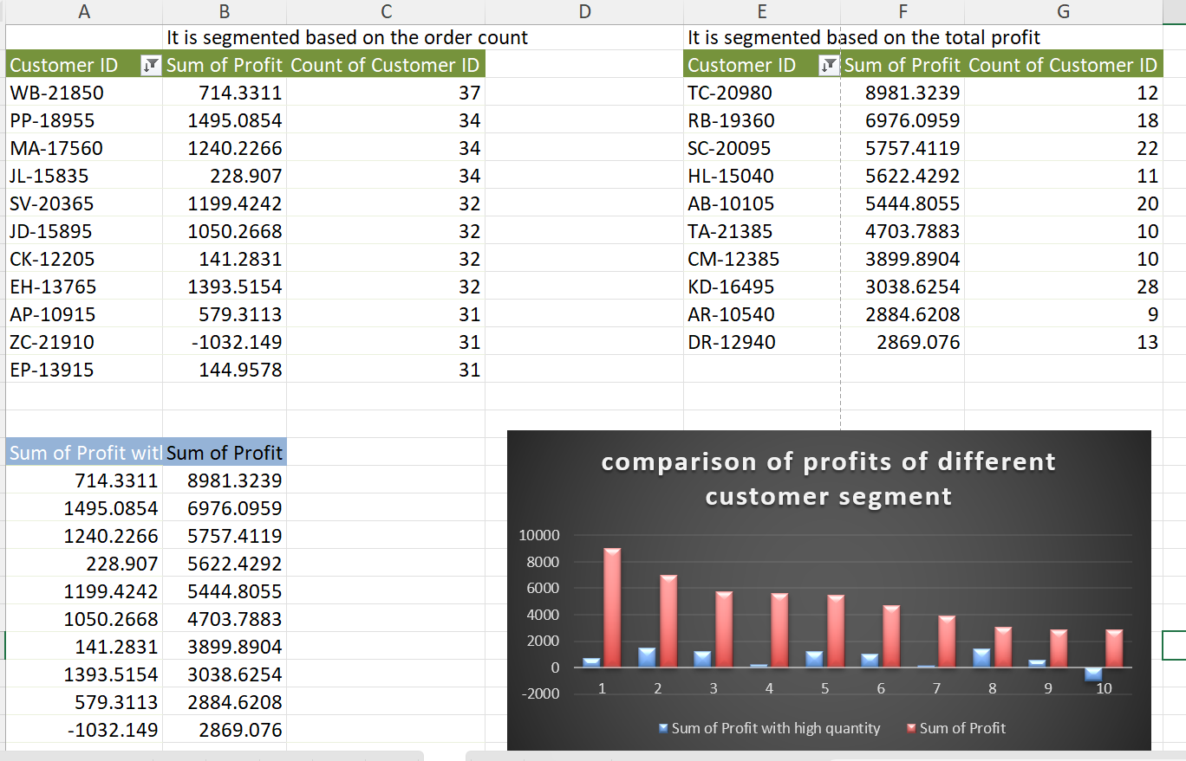
Q3
Insights: Here I have segmented the customer into two types
1. The highest no of orders
2.The highest profit from a customer
Through this, I was able to identify the most valuable segment.
Inference: I was able to find the most valuable segment

Slide 5
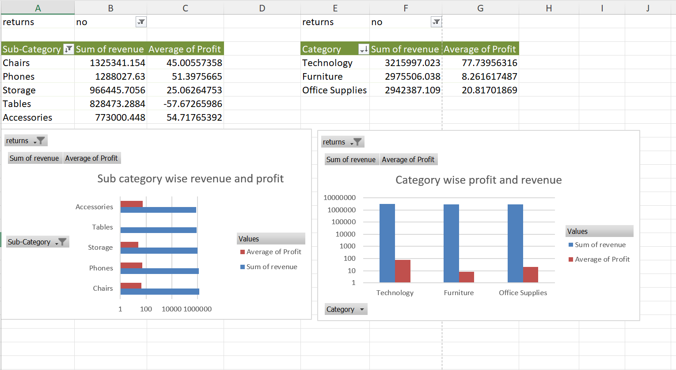
Q4
Insights: Using the pivot table I segmented the products based on category and sub_category.
Then I found the top most revenue ,also added the profit margin
Inference: I found the top products with high revenue based on category and sub-category.

Slide 6
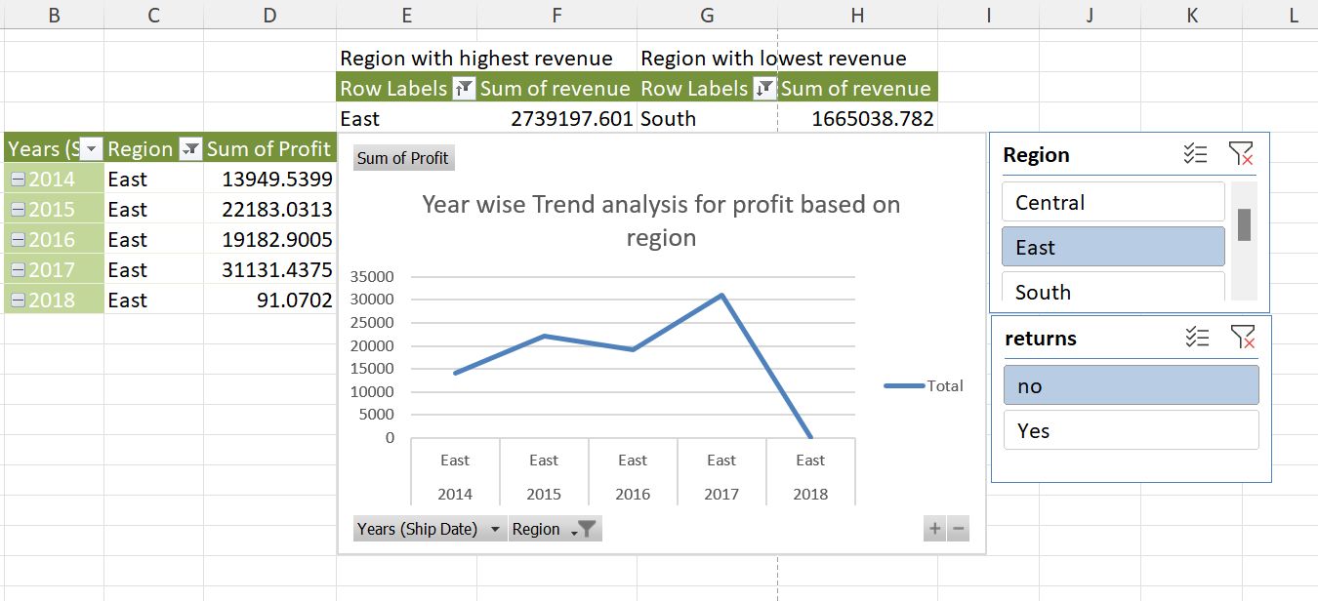
Q5
Insights: I have compared sales performance of different regions and found the regions with highest and lowest sales. Also, I compared the regions year wise profit analyzation
Inference: I found the highest and lowest sales based on region and performed trend analysis for profit based on region.Through the trend analysis I can see the decrease in profit in the current year.

Slide 7
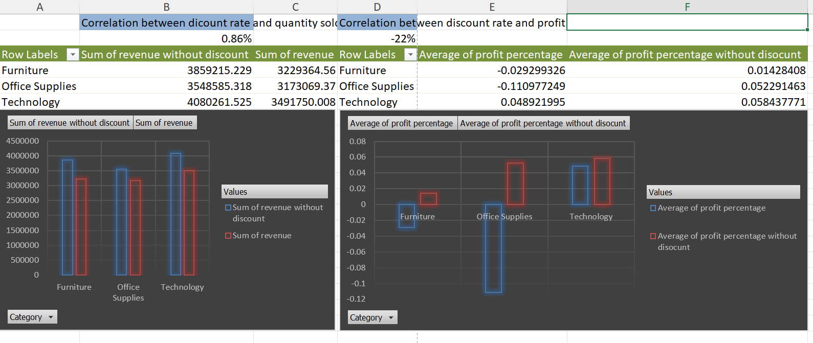
Q6
Insights: I have analyzed the impact of discounts on sales and profit by comparing the values before discount reduction and after discount reduction. also found the co-relationship between the discount and quantities and profit
Inference: Through the discount comparison we can see the difference in profit and revenue because of the discount.
Correlation : discount and quantity has a positive correlation
discount and profit have negative correlations

Slide 8
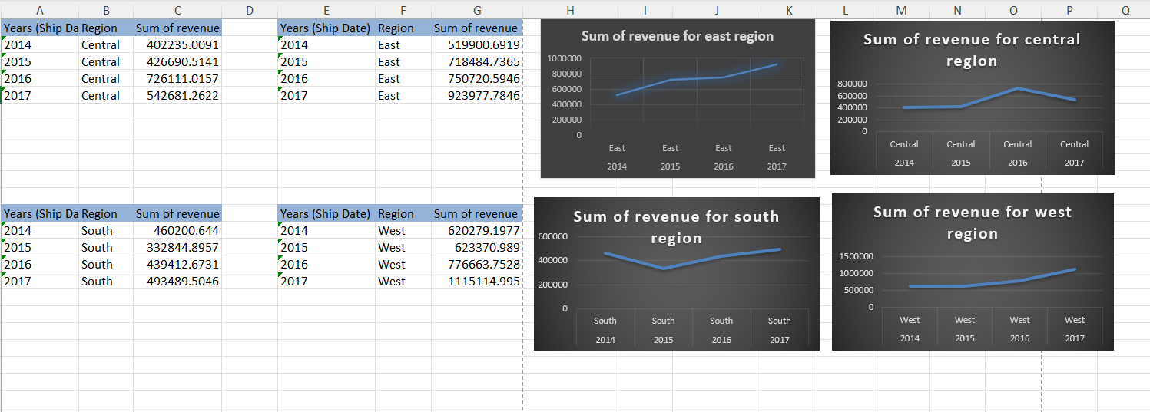
Q7
Insights:I calculated the revenue for each region and performed trend analysis on each region
Inference: based on the trend analysis we can clearly see that the east region has perfomed well in each year and its revenue haven’t dropped in those years . If we are planning to expand our business east region is best place .

Slide 9
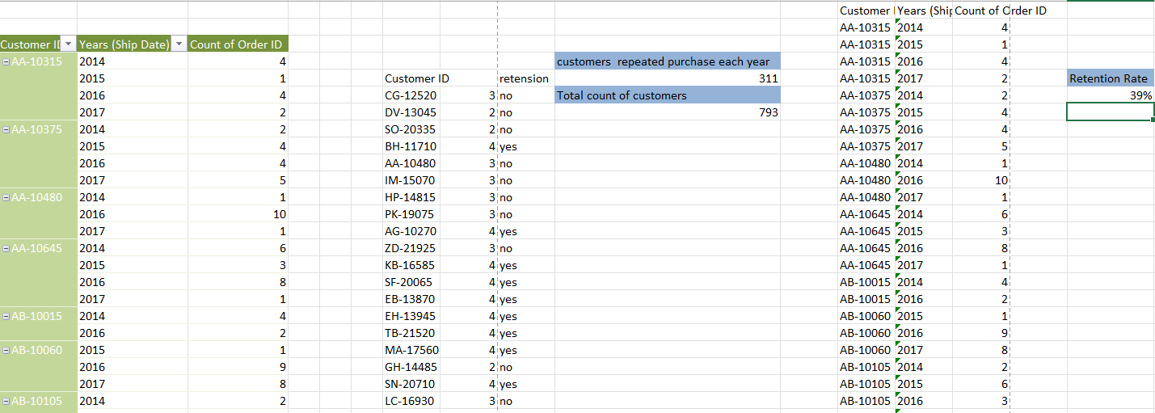
Q8
Insights: I used pivot table to extract data based on the customers order year wise and calculated the churn rate of the customer
Inference: Based on above analyzation we are able to find the retention rate.
Steps to improve retention:1.we can provide more discouts
2.We can work more on promotions and loyalty points can also be used effectively to attract customers.

Slide 10
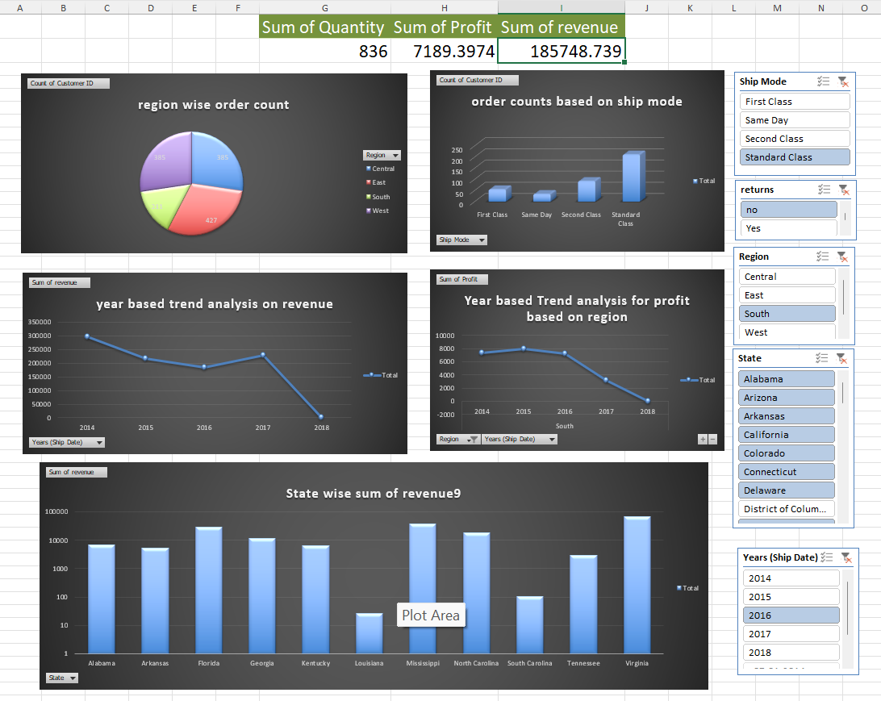
DASHBOARD

Slide 11
THANK YOU

